Slide 1
Computer Vision
Cameras, Lenses and Sensors

Slide 2
Cameras, lenses and sensors
Camera Models
Pinhole Perspective Projection
Affine Projection
Camera with Lenses
Sensing
The Human Eye

Slide 3
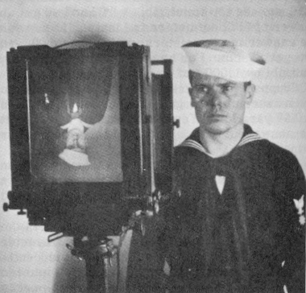
Images are two-dimensional patterns of brightness values.
Figure from US Navy Manual of Basic Optics and Optical Instruments, prepared by Bureau of
Naval Personnel. Reprinted by Dover Publications, Inc., 1969.
They are formed by the projection of 3D objects.

Slide 4
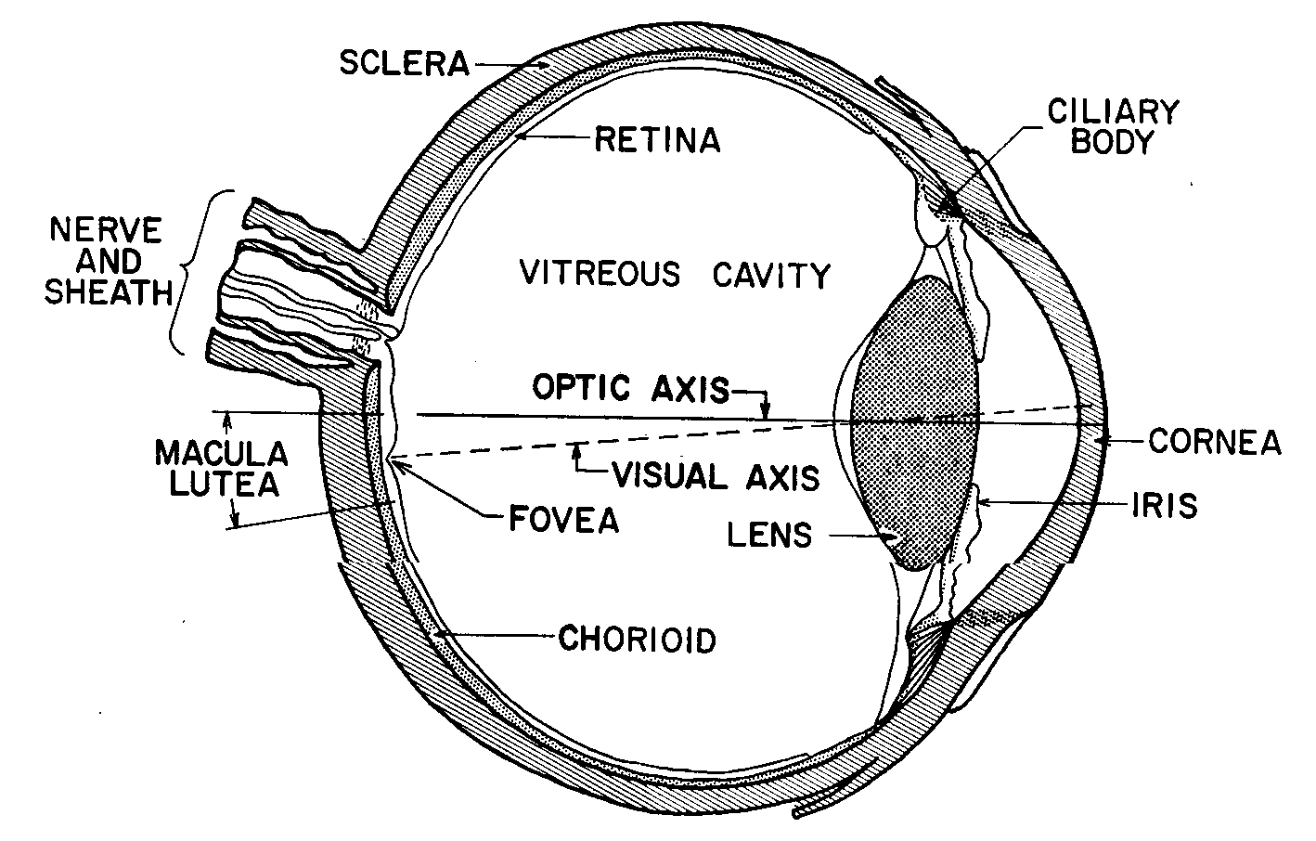
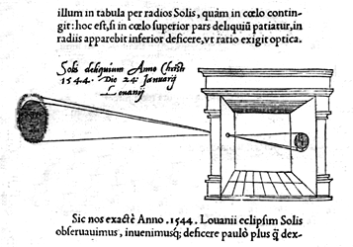
Animal eye:
a long time ago.
Photographic camera:
Niepce, 1816.
Pinhole perspective projection: Brunelleschi, XVth Century.
Camera obscura: XVIth Century.

Slide 5
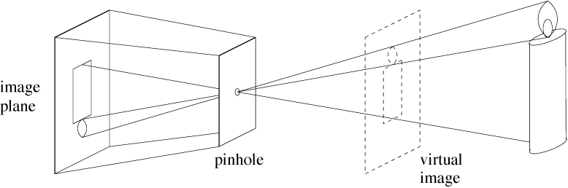
Pinhole Cameras

Slide 6
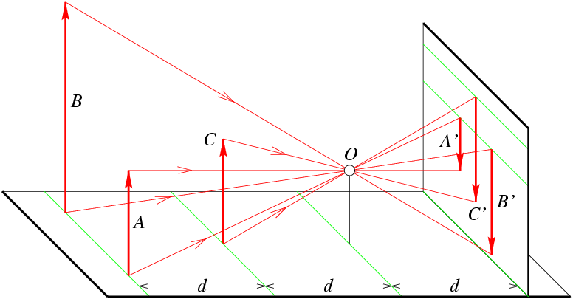
Distant objects appear smaller

Slide 7
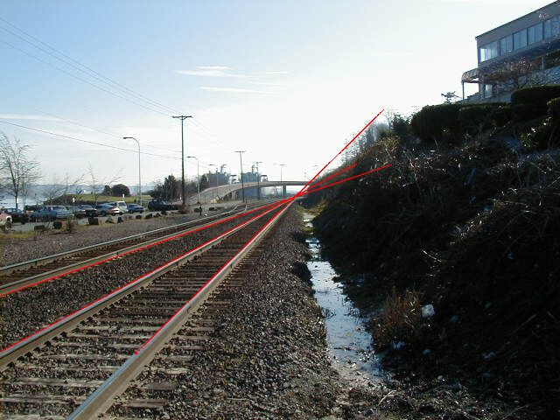
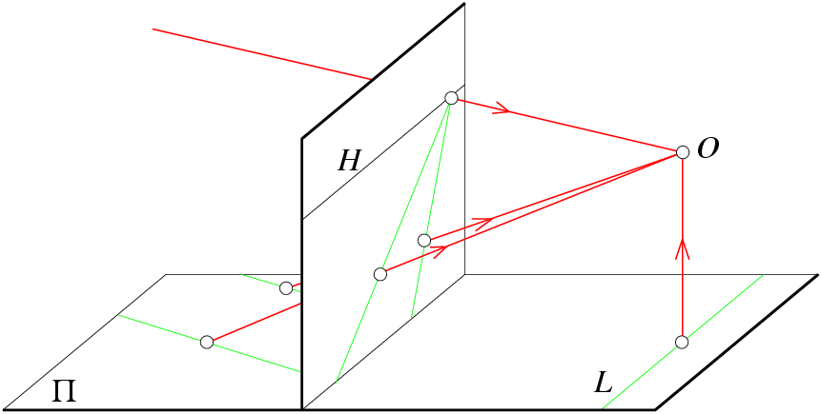
Parallel lines meet
vanishing point

Slide 8
Vanishing Points
each set of parallel lines (=direction) meets at a different point
The vanishing point for this direction
Sets of parallel lines on the same plane lead to collinear vanishing points.
The line is called the horizon for that plane
Good ways to spot faked images
scale and perspective don’t work
vanishing points behave badly
supermarket tabloids are a great source.

Slide 9
Geometric properties of projection
Points go to points
Lines go to lines
Planes go to whole image
or half-plane
Polygons go to polygons
Degenerate cases:
line through focal point yields point
plane through focal point yields line

Slide 10
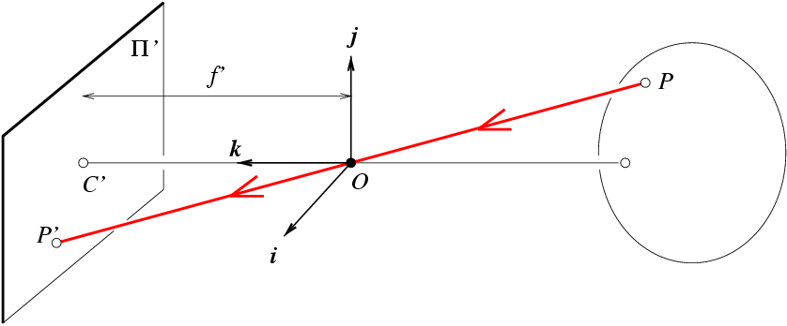
Pinhole Perspective Equation
A point P(x,y,z) and its projection onto the image plane p(x’,y’,z’). z’=f’ by definition
C’: image center
OC’: optical axis
OP’=λOP ➔ x’=λx, y’=λy, z’=λz

Slide 11
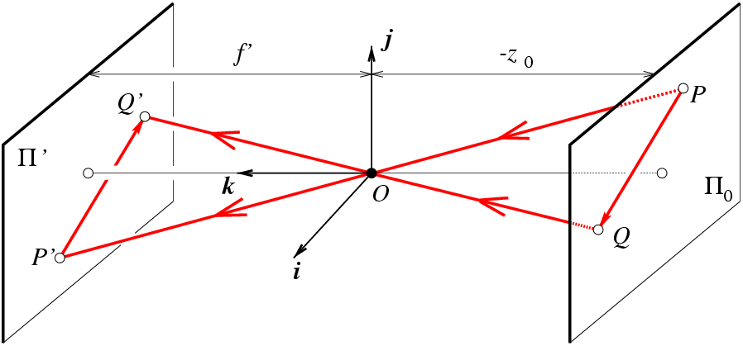
Affine projection models:
Weak perspective projection
is the magnification.
When the scene depth is small compared its distance from the Camera, m can be taken constant: weak perspective projection.

Slide 12
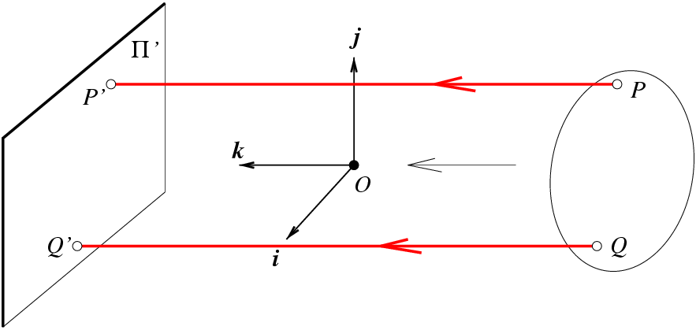
Affine projection models:
Orthographic projection
When the camera is at a
(roughly constant) distance
from the scene, take m=1.

Slide 13
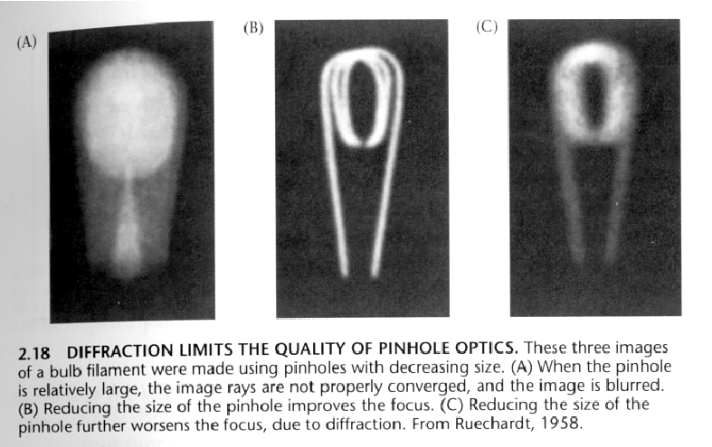
Limits for pinhole cameras
Notes:
C 的入光亮也變少變更案
Diffraction ＝ 繞射

Slide 14
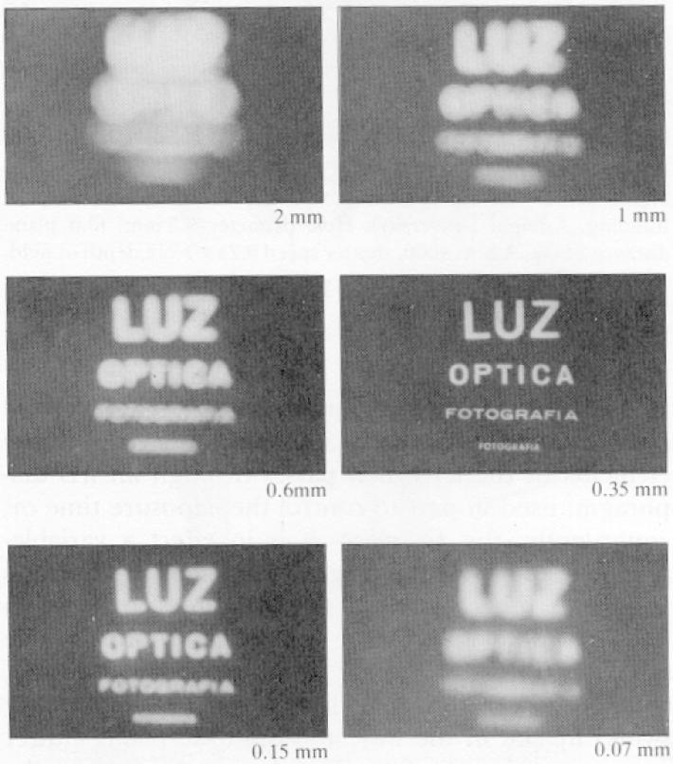
Size of pinhole
Pinhole too big –many directions are averaged, blurring the image
Pinhole too small- diffraction effects blur the image
Generally, pinhole cameras are dark, because a very small set of rays from a particular point hits the screen.

Slide 15
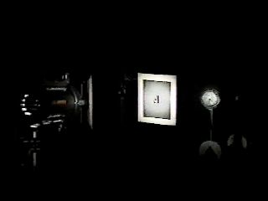
Camera obscura + lens
➔

Slide 16
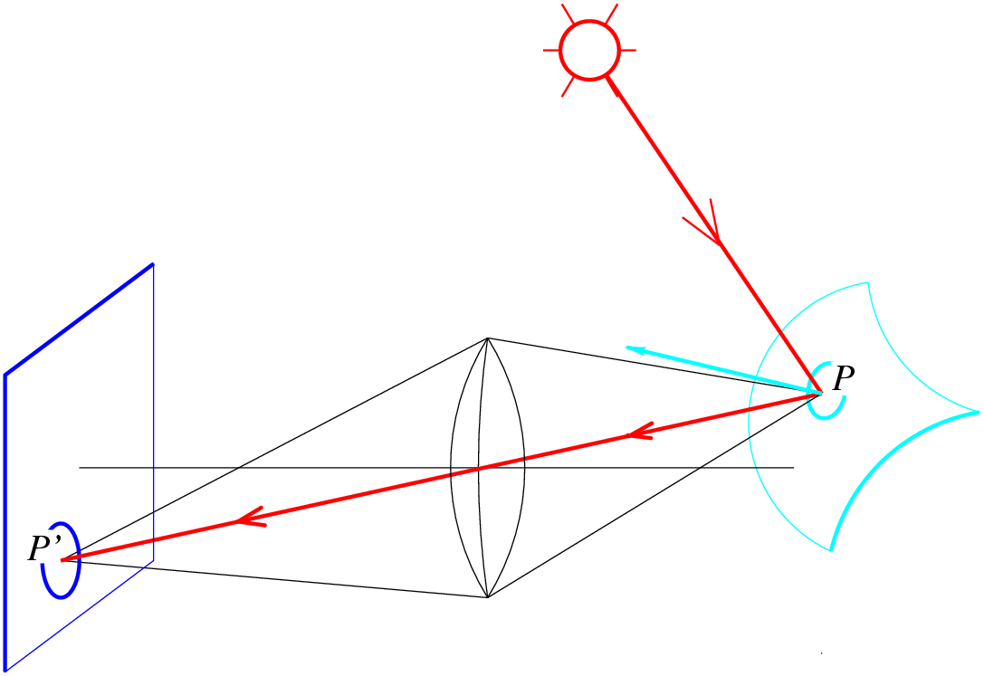
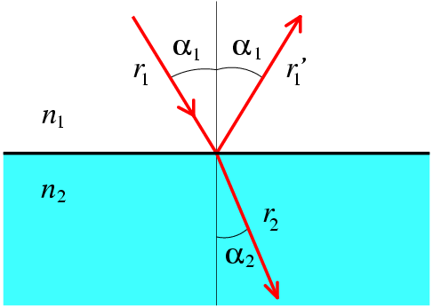
Lenses
Snell’s law
n₁ sin α₁ = n₂ sin α₂
Descartes’ law

Slide 17
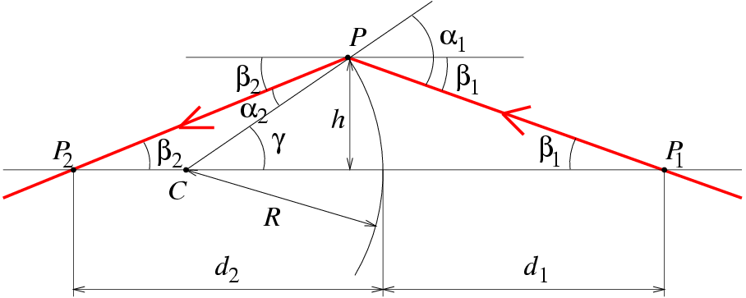
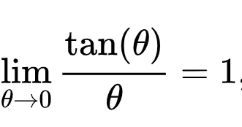
Paraxial (or first-order) optics
入射角 = alph1 + beta
Snell’s law:
n₁ sin α₁ = n₂ sin α₂
Small angles:
n₁ α₁ ≈ n₂α₂

Slide 18
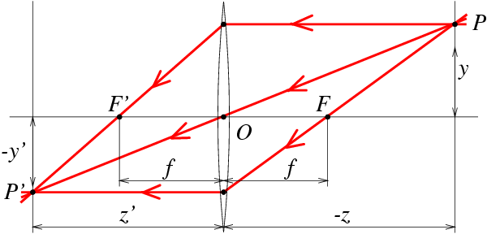
Thin Lenses
spherical lens surfaces; incoming light ± parallel to axis; thickness << radii; same refractive index on both sides

Slide 19
Thin Lenses
http://www.phy.ntnu.edu.tw/java/Lens/lens_e.html

Slide 20
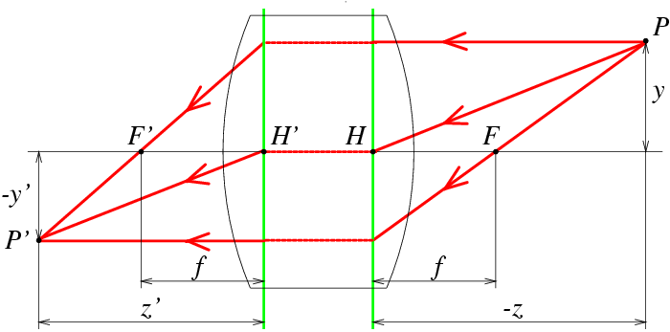
Thick Lens
For large angles, use a third-order Taylor expansion of the sine function:

Slide 21
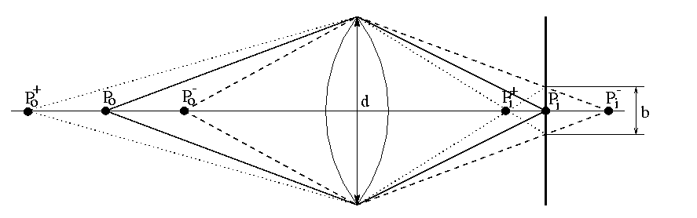
The depth-of-field
➔

Slide 22
The depth-of-field
yields
相似形
得到
Similar formula for
➔

Slide 23
The depth-of-field
decreases with d, increases with Z₀
strike a balance between incoming light and
sharp depth range
➔

Slide 24
Deviations from the lens model
3 assumptions :
1. all rays from a point are focused onto 1 image point
2. all image points in a single plane
3. magnification is constant
deviations from this ideal are aberrations
➔

Slide 25
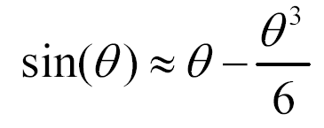
Aberrations
geometrical : small for paraxial rays, study through 3rd order optics
chromatic : refractive index function of wavelength

Slide 26
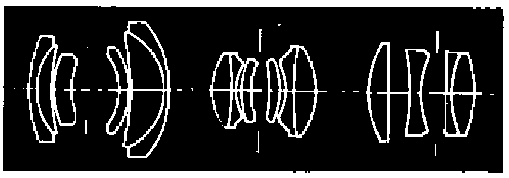
Geometrical aberrations
spherical aberration
astigmatism
distortion
coma
aberrations are reduced by combining lenses
➔

Slide 27
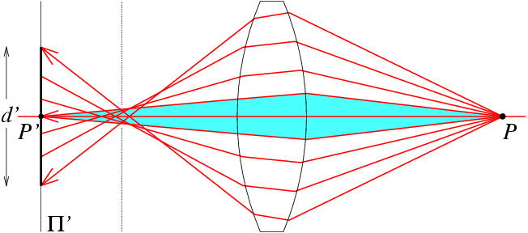
Spherical aberration
rays parallel to the axis do not converge
outer portions of the lens yield smaller focal lengths
➔

Slide 28
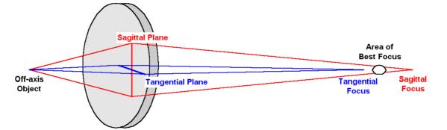
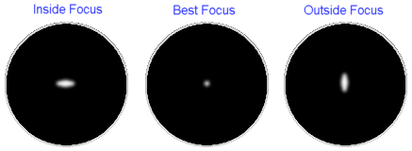
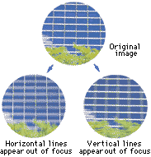
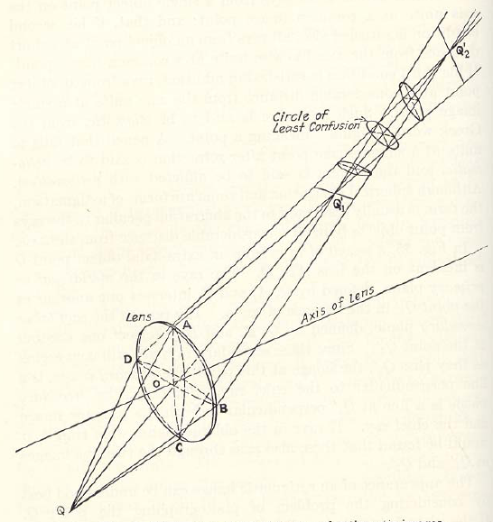
Astigmatism
Different focal length for inclined rays

Slide 29
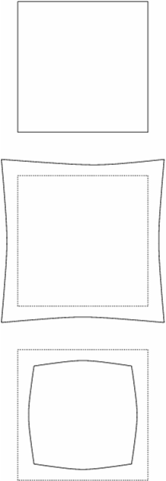
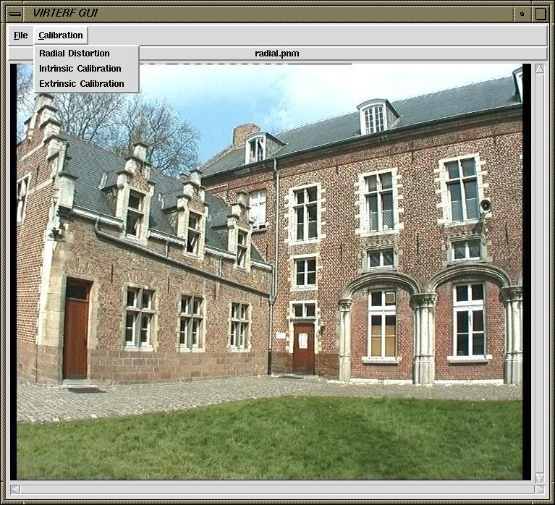
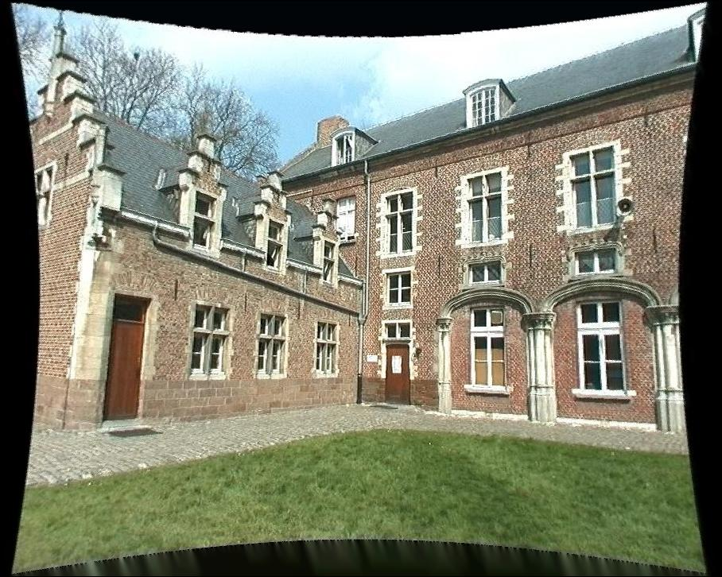
Distortion
magnification/focal length different
for different angles of inclination
pincushion
(tele-photo)
barrel
(wide-angle)
Can be corrected! (if parameters are know)

Slide 30
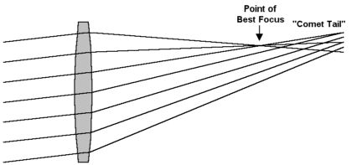
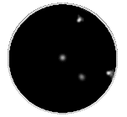
Coma
point off the axis depicted as comet shaped blob

Slide 31
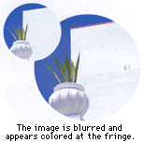
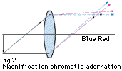
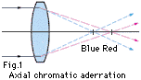
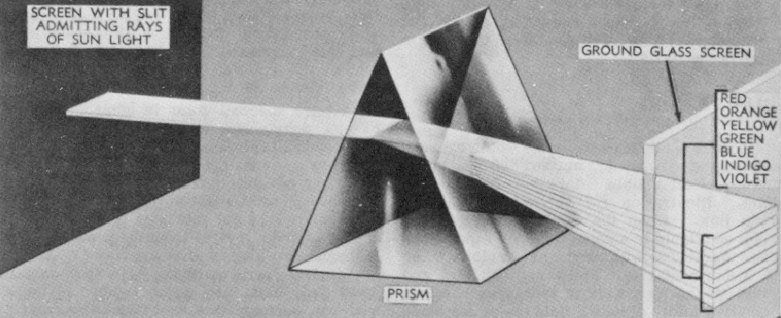
Chromatic aberration
rays of different wavelengths focused
in different planes
cannot be removed completely
sometimes achromatization is achieved for
more than 2 wavelengths
➔

Slide 32
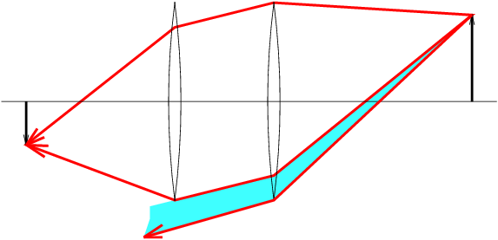
Vignetting
The shaded part of the beam never reaches the second lens. Additional apertures and stops in a lens further contribute to vignetting.

Slide 33
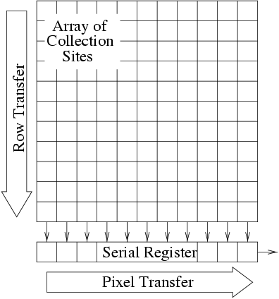
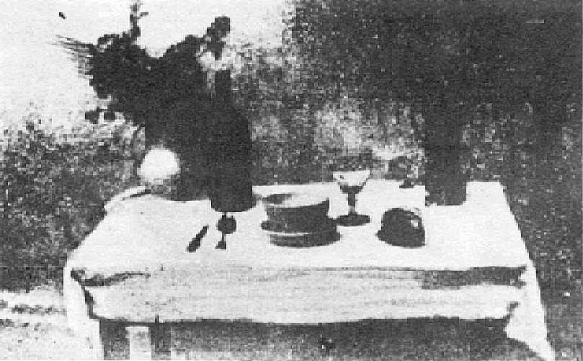
Photographs
(Niepce,
“La Table Servie,” 1822)
Collection Harlingue-Viollet.
Milestones:
Daguerreotypes (1839)
Photographic Film (Eastman,1889)
Cinema (Lumière Brothers,1895)
Color Photography
(Lumière Brothers, 1908)
Television
(Baird, Farnsworth, Zworykin, 1920s)
CCD Devices (1970)
more recently CMOS

Slide 34
Cameras
we consider 2 types :
1. CCD
2. CMOS
➔

Slide 35
CCD
separate photo sensor at regular positions
no scanning
charge-coupled devices (CCDs)
area CCDs and linear CCDs
2 area architectures :
interline transfer and frame transfer
photosensitive
storage
➔

Slide 36
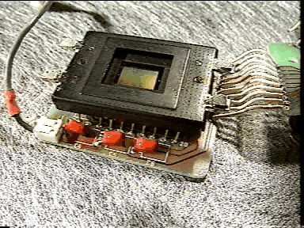
The CCD camera

Slide 37
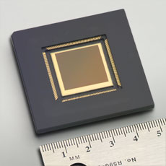
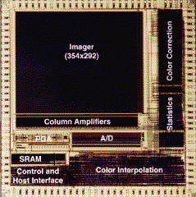
CMOS
Same sensor elements as CCD
Each photo sensor has its own amplifier
More noise (reduced by subtracting ‘black’ image)
Lower sensitivity (lower fill rate)
Uses standard CMOS technology
Allows to put other components on chip
Foveon
4k x 4k sensor
0.18μ process
70M transistors

Slide 38
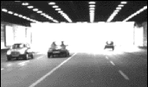
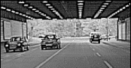
CCD vs. CMOS
Recent technology
Standard IC technology
Cheap
Low power
Less sensitive
Per pixel amplification
Random pixel access
Smart pixels
On chip integration with other components
Mature technology
Specific technology
High production cost
High power consumption
Higher fill rate (amount of pixel picture vs. space in between)
Blooming
Sequential readout

Slide 39
Color cameras
We consider 3 concepts:
Prism (with 3 sensors)
Filter mosaic
Filter wheel
… and X3

Slide 40
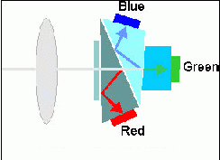
Prism color camera
Separate light in 3 beams using dichroic prism
Requires 3 sensors & precise alignment
Good color separation

Slide 41
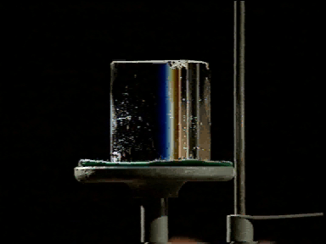
Prism color camera

Slide 42
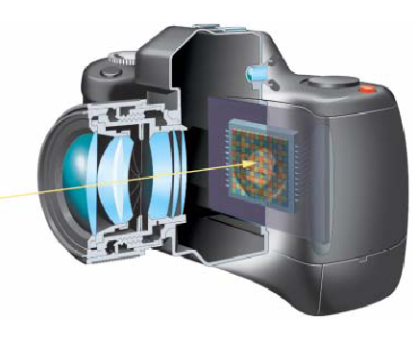
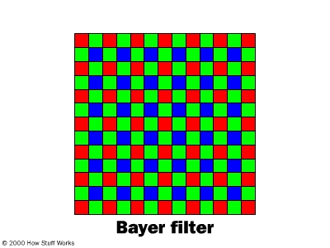
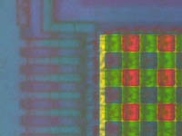
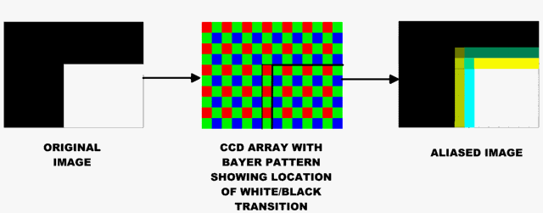

Filter mosaic
Coat filter directly on sensor
Demosaicing (obtain full color & full resolution image)
Notes:
非真正的RGB
是用filter interpolate 出來的

Slide 43

Filter wheel
Rotate multiple filters in front of lens
Allows more than 3 color bands
Only suitable for static scenes

Slide 44
Prism vs. mosaic vs. wheel
approach
# sensors
Separation
Cost
Framerate
Artefacts
Bands
Prism
3
High
High
High
Low
3
High-end
cameras
Mosaic
1
Average
Low
High
Aliasing
3
Low-end
cameras
Wheel
1
Good
Average
Low
Motion
3 or more
Scientific applications

Slide 45





New color CMOS sensor Foveon’s X3
smarter pixels
better image quality

Slide 46
Reproduced by permission, the American Society of Photogrammetry and
Remote Sensing. A.L. Nowicki, “Stereoscopy.” Manual of Photogrammetry,
Thompson, Radlinski, and Speert (eds.), third edition, 1966.
The Human Eye
Helmoltz’s
Schematic
Eye

Slide 47

The distribution of rods and cones across the retina
Reprinted from Foundations of Vision, by B. Wandell, Sinauer
Associates, Inc., (1995). © 1995 Sinauer Associates, Inc.
Cones in the
fovea
Rods and cones in
the periphery
Reprinted from Foundations of Vision, by B. Wandell, Sinauer
Associates, Inc., (1995). © 1995 Sinauer Associates, Inc.

